Slide 1
Blood Glucose Level monitoring Device
Amit Chakma

Slide 2
Table of contents
01
Introduction
02
Concept
03
Designing the concept.
04
Modeling

Slide 3
01
Introduction

Slide 4
Diabetics Patient
Diabetic patients are increasing day by day.
Obesity lead to higher chance of diabetics.
Insulin intake in everyday routine.
Measuring Glucose level .

Slide 5
Problem
Finger stick used to measure the to take blood sample.
Strip sample place inside the device to measure the glucose level.
Taking blood sample by pinching a finger with sharp needle.
One time test not synchronous.

Slide 6
02
Concept

Slide 7
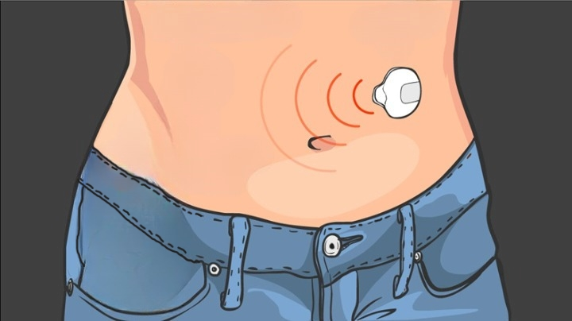
Continuous Blood Monitoring Device
The device sends continuous data to users smartphone
Alerts user in case of emergency.
Sends data to the medical team.
Use MQTT protocol.

Slide 8
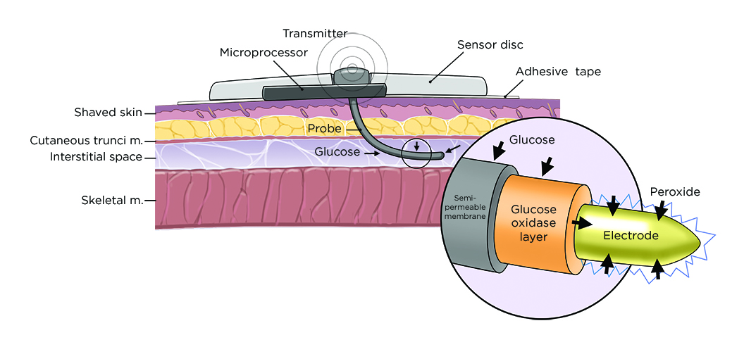
How it works?

Slide 9
03
Designing the concept

Slide 10
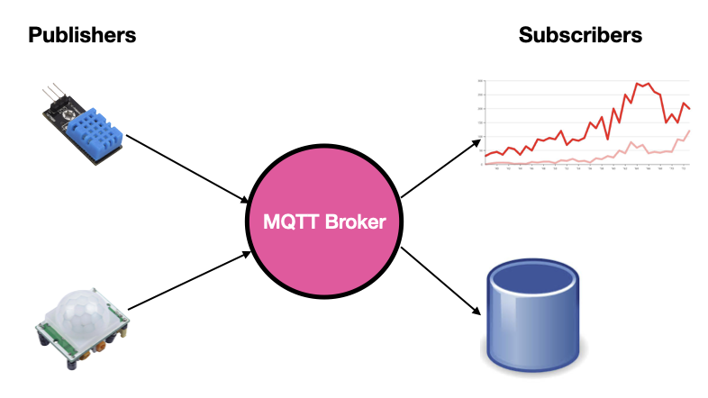
MQTT Protocol
Consumes low power .
MQTT is a lightweight protocol.
low-bandwidth environments

Slide 11
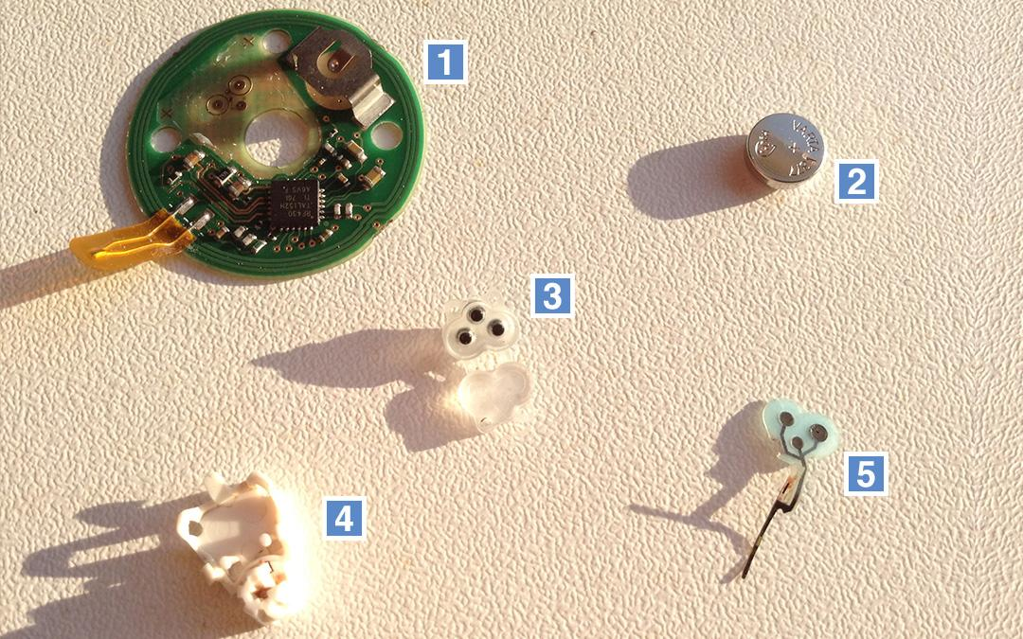
Hardware
PCB with RF430 chip for short range transmission
Cell battery 1.5V
Connector for connecting sensor and PCB.
Protection.
Sensor.

Slide 12
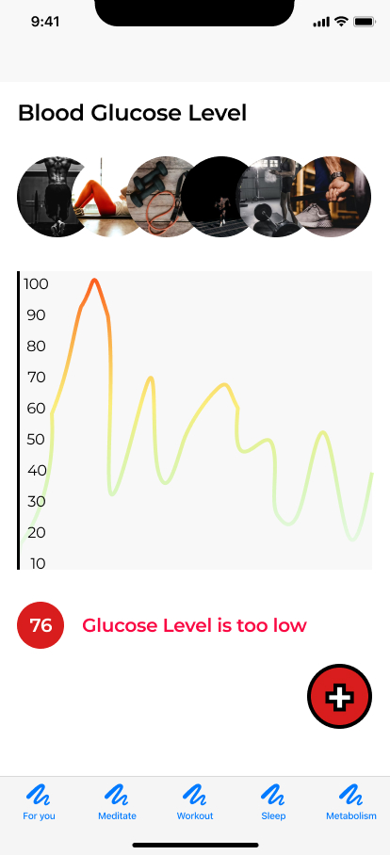
User Interface
Graph showing real time data
Red alert for low or too high glucose level.
+ button to connect to medical teams.
The app can also keep track of food consumed by the user.
Some motivational quotes will keep the user motivated.

Slide 13
04
Modeling

Slide 14
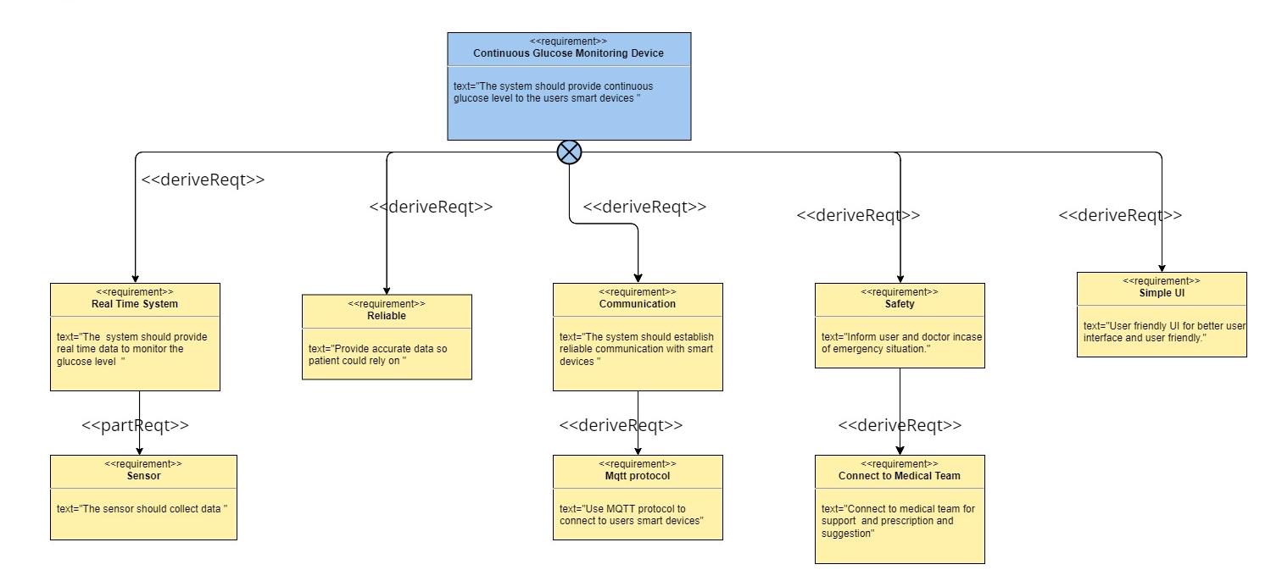
Requirement Diagram

Slide 15
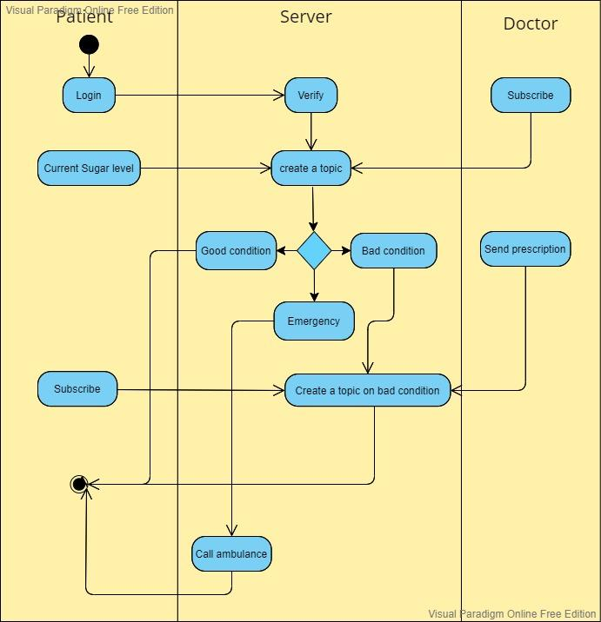
Activity Diagram

Slide 16
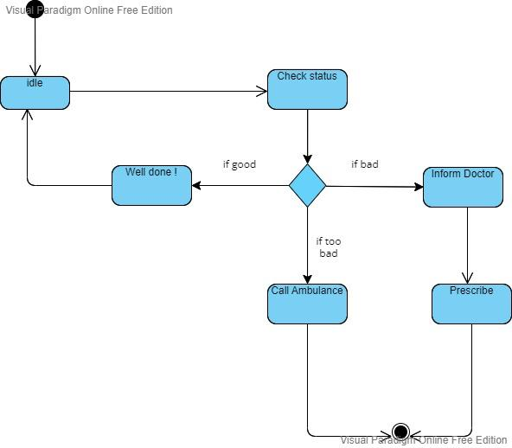
State machine Diagram

Slide 17
Thank You

